Slide 1


Recipe for PEACE at Mealtimes

Slide 2

1-2-3 C.A.L.M.
1. Present the food.
2. Practice often.
3. Patience, patience, patience.
  Consider the snacks. Every bite counts.
  Add something new & Allow exploration.
  Let them feel hungry.
  Make foods together.
  For further examples, watch “No come nada” / “My kid won’t eat anything” video

Slide 3
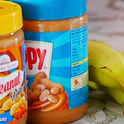
Consider the snacks. Every bite counts.
Offer 2 food groups at each snack.
  Each food group provides key nutrients. Offering foods from at least two groups increases the nutritional quality of the snack.
  Examples:
  Cheese (dairy) and crackers (grain)
  Beans (protein) on a bolillo (grain)
  Sliced banana (fruit) and peanut butter (protein)

Slide 4
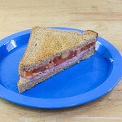
Consider the snacks. Every bite counts.
Any food can be a snack food.
  Examples:
  Leftover beans and rice
  ½ Turkey sandwich
  Yogurt with fresh fruit
  Snacks don’t have to be ”snack foods” that are often high in extra calories. If a child eats high quality foods at snack time, we can reduce worry if a child does not eat well at a meal later in the day.

Slide 5
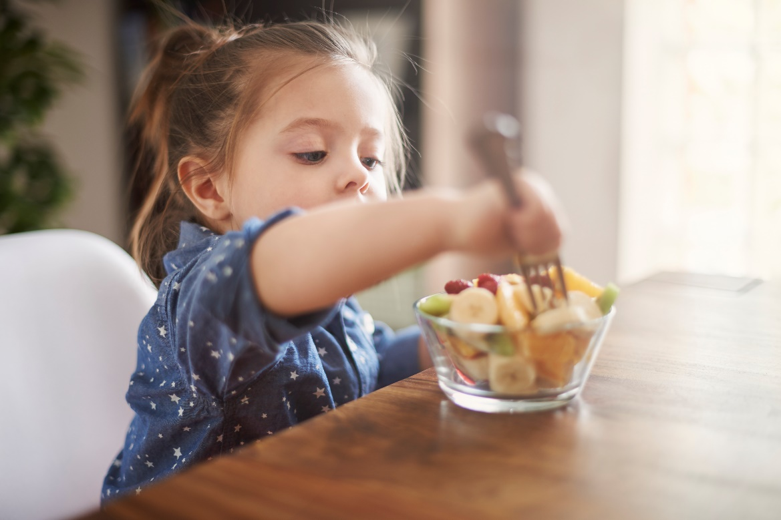
Consider the snacks. Every bite counts.
Size does matter.
  Offer small portions. Remember that there will be another opportunity to eat later.
  Example:
  4 to 8 oz. of milk and ½ pan dulce
  1 small muffin or mantecada and ½ banana
Image by gpstudio on Freepik

Slide 6
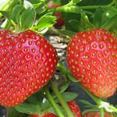
Add something new & Allow exploration.
  Present the food on the same plate as preferred foods. Do NOT pressure your child to eat or explore the food. They will explore when and if they are ready.
  Add the new food openly. Do not hide it.
  Example:
  Be Positive: “Let’s try something new today. Where would you like me to put it?”
  Be Honest: “This is your favorite smoothie. I mixed it with a little bit of fresh strawberry.”

Slide 7
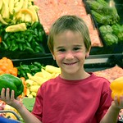
Add something new & Allow exploration.
  Encourage exploration.
  Children explore things with all of their senses. They use their eyes, nose, and fingers to learn about the world. Talking about how a food looks, smells or feels can make it less scary..
  Example:
  What color is it?
  What shape is it?
  Is it hard or soft?

Slide 8
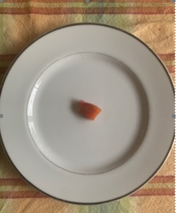
Add something new & Allow exploration.
  Just 1 small piece keeps the PEACE.
  Trying something new can be hard or scary for a lot of people. Starting with a small piece, the size of the tip of a little finger, can make it less scary to accept on the plate and explore.
  Example:
  1 green pea or bean
  1 baby spoonful of mashed potatoes
  2 grains of rice

Slide 9
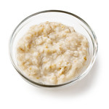

Add something new & Allow exploration.
  Kids (and adults) need time to adjust to new foods, Keep trying.
  Learning something new takes time, patience and many attempts. Kids (and adults) may need to try a new food different ways before they find a way they like.
  Example:
  Plain oatmeal
  Oatmeal with cinnamon
  Oatmeal with applesauce

Slide 10

Let them feel hungry.
  Offer meals and snacks every 2 to 3 hours.
  Offering breaks between meals and snacks gives children an opportunity to listen to their bodies. It can help them eat from hunger instead of boredom or habit.
  Sample schedule:
  8am-Breakfast
  10am-snack
  12:30pm-Lunch
  3:00pm-snack
  6:00pm-Dinner
  8:00pm-snack

Slide 11

Let them feel hungry.
  Offer food at consistent times.
  This helps children to understand when it’s time to eat, instead of play. This will be important when they get to school with set mealtimes.
  Example:
  “We had our snack, now its time for us to go outside and play."

Slide 12
Let them feel hungry.
  Limit meals to 20 to 30 minutes.
  Most children eat most of what they are going to eat in the first 15 minutes. When the child is done eating, remove the food and move on to do something else. Every meal should have a beginning, a middle, and an end.
  Example:
  “it looks like you aren’t hungry any longer. Let’s put the food away and do something else.”

Slide 13
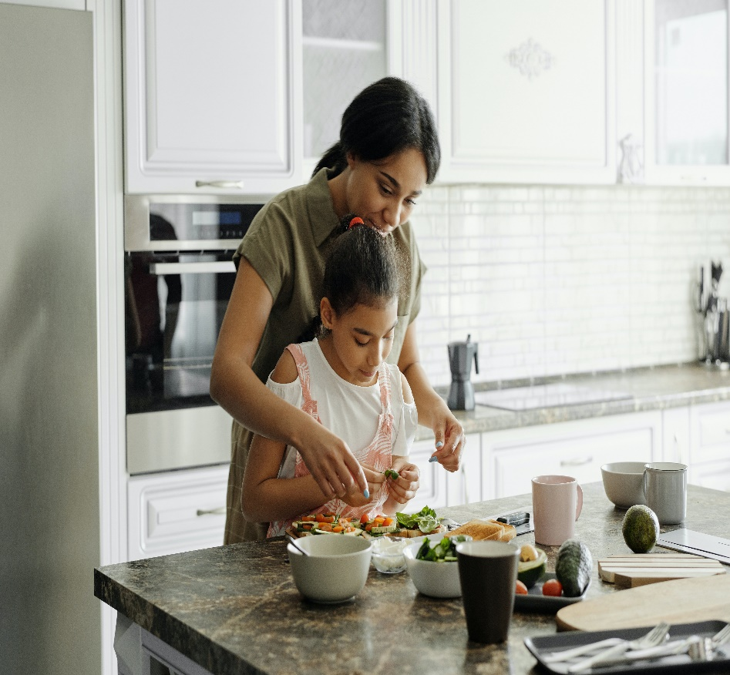
Make foods together.
  Success in the mess.
  Every success starts with a mess, even in a kitchen. Working with food in the kitchen can be messy. It brings us closer to the food, allowing us to see it, touch it, smell it, and watch food change in the process. Success is working together as a team.
  Example:
  Washing fruits and vegetables
  Mixing ingredients
  Rolling dough

Slide 14
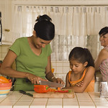
Make foods together.
  Connection without rejection.
  Making food together allows you and your child to connect with food in a positive way since the focus is not on eating. The joy is in spending time together, learning, and exploring.
  Example:
  Conversation: “How was your day today?”
  Laughter: When something goes wrong OR right
  Enjoying each other: “I like the way you did that.”

Slide 15
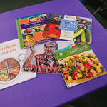
Make foods together.
  Kids can learn while helping.
  Cooking requires learning new skills. Its fun to practice those skills together.
  Examples:
  Reading the recipe
  Measuring ingredients
  Using kitchen tools

Slide 16

Additional Resources
If you are concerned about your child’s feeding, complete the Infant/Child Feeding Questionniare (ICFQ) at https://questionnaire.feedingmatters.org/questionnaire
To learn about Pediatric Feeding Disorder and find additional resources, visit www.feedingmatters.org

